Slide 1
Results of Recent Grazing Occultation Observations
presented
2014 July 13, UMD Obs., College Park, MD
32nd Annual IOTA Meeting
David W. Dunham

Slide 2
Maps for the grazing occultation of μ Arietis on 2007 June 12
Showing locations of the expeditions, and of the observers at the expedition near Hockley, Texas
I independently discovered the close duplicity of this star during a graze over the s. suburbs of St. Louis in Jan. 1969. A month earlier, unknown to me until a year later, Christian de Vegt discovered the duplicity during a photoelectric recording of a total occultation from Hamburg Observatory. In mid 2007, the stars were near periastron and so more difficult to resolve.
Notes:
2

Slide 3
Path across Texas; total occultation is south of path
Our expedition →
Rick →
Frankenberger
Notes:
3

Slide 4
Path near Waller & Hockley, Texas (US 290 area)
A
←meet
Area shown in detail
in next slide
Hockley
Offsets are -0.7 and -1.7
Notes:
4

Slide 5
Details of Hegar Rd./Imhof Rd. sites used n. of Hockley, Texas
R. Nugent
←D. Clark (2)
P. Maley
Dunham N. remote/Cudnik
D. Dunham visual
←R. Sandy
←met
D. ↑
Stockbauer
D. Dunham S. remote→
Notes:
5

Slide 6
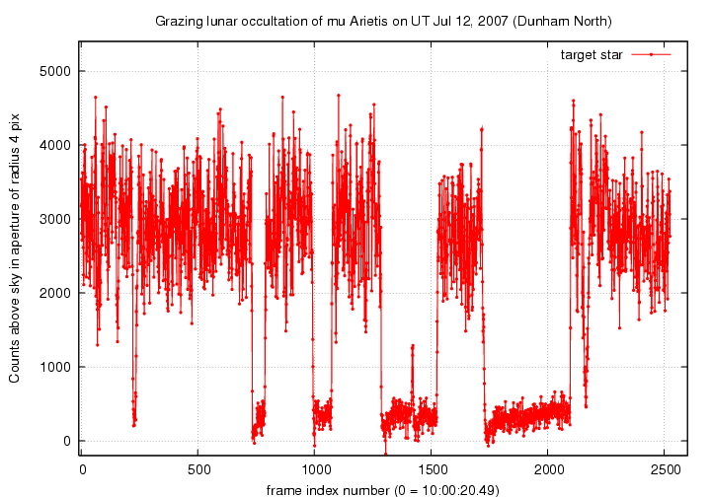
Notes:
6

Slide 7
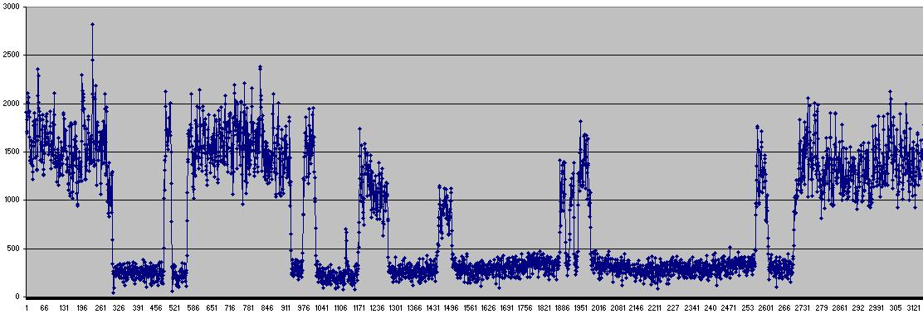
Light curve from Bob Sandy’s video recording of the 2007 June 12th grazing occultation of μ Arietis
Notes:
7

Slide 8
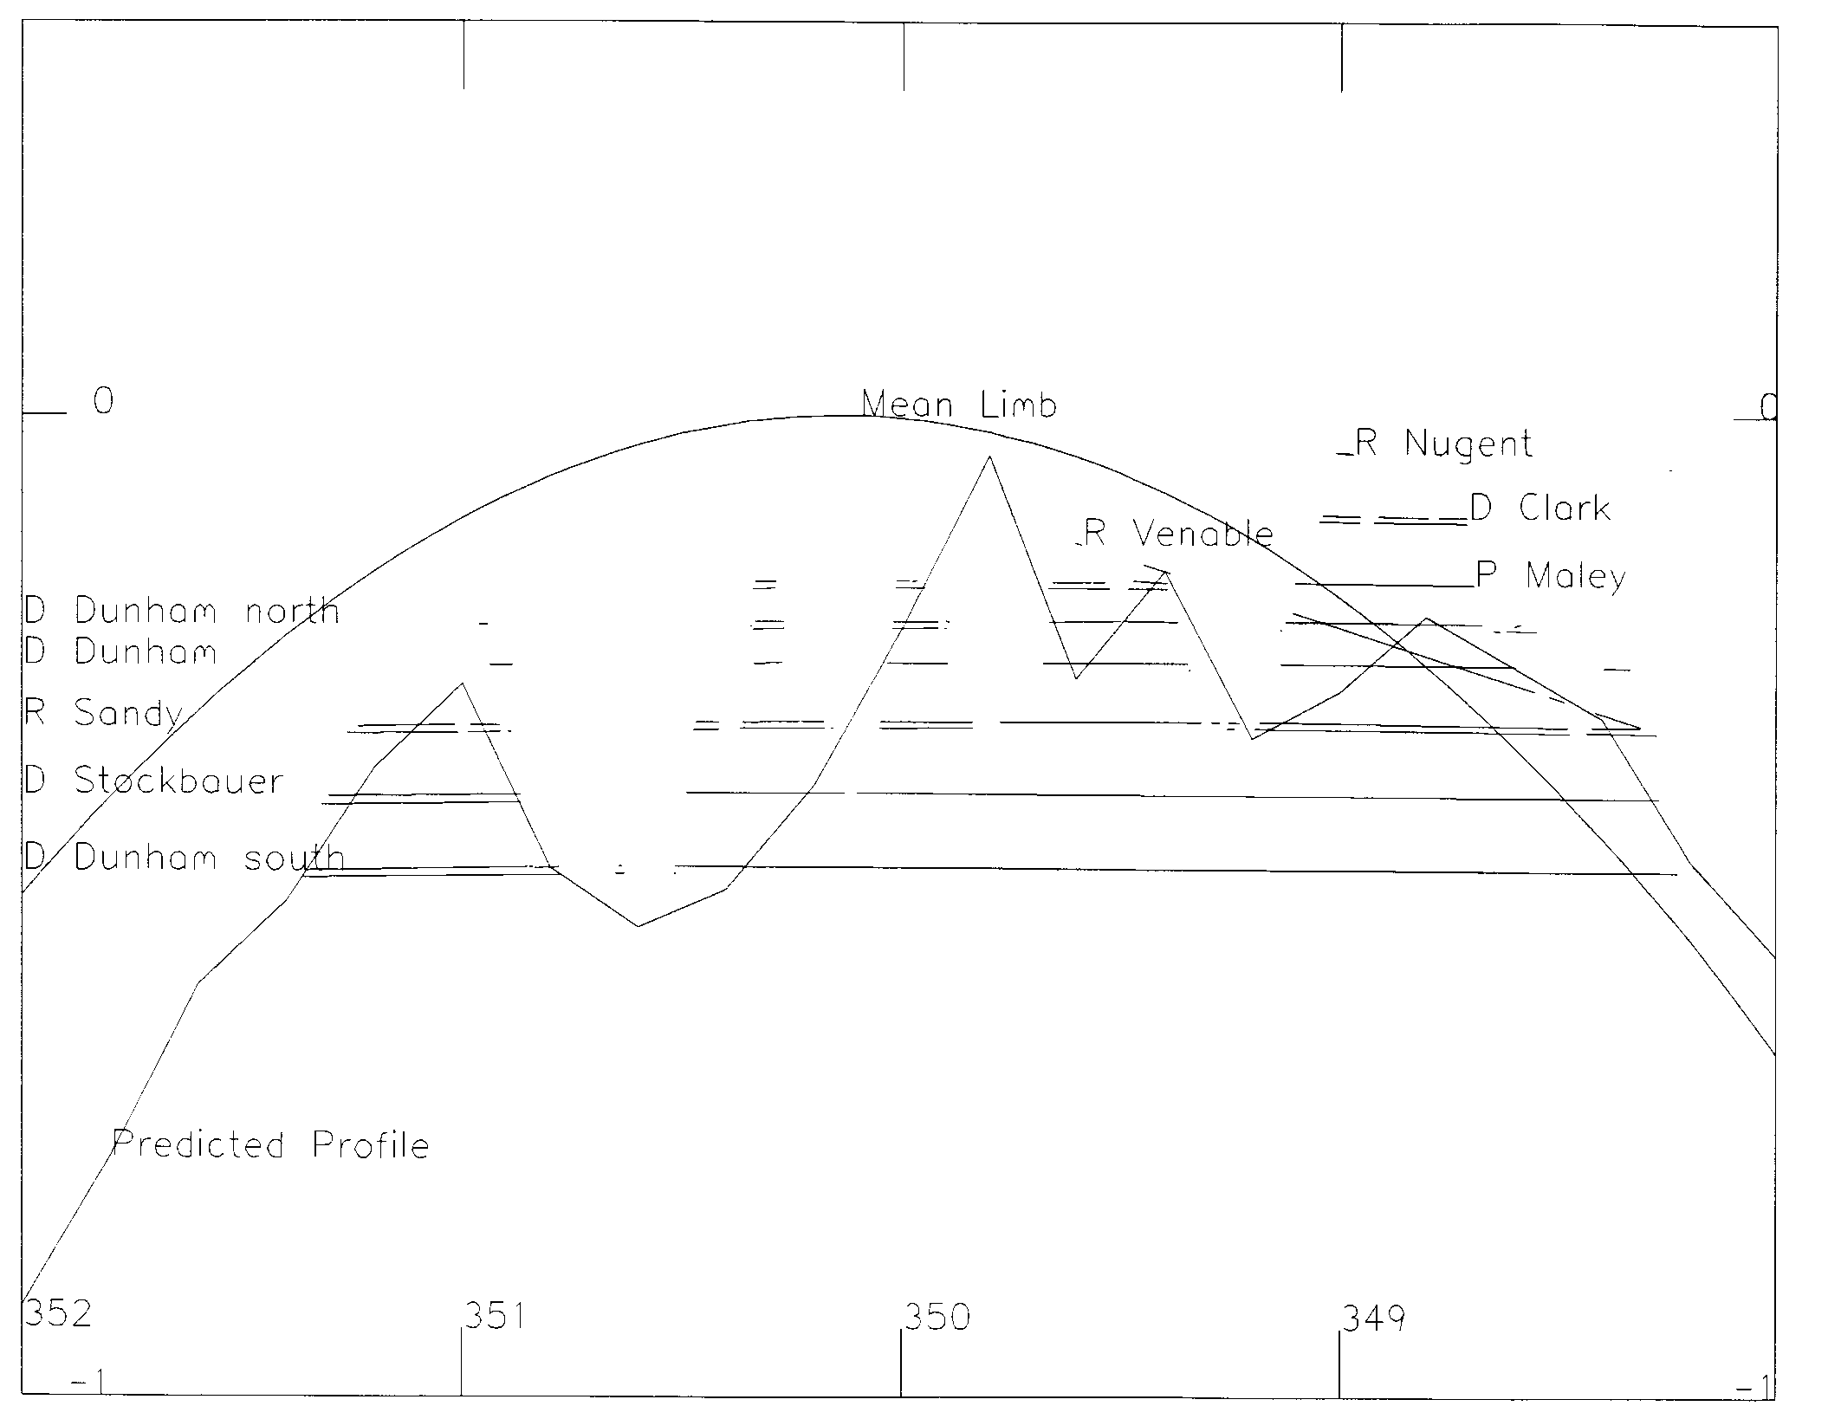
Reduction Profile of Grazing Occultation of the Double
Star μ Arietis (ZC 399) observed in Texas and Louisiana,
2007 June 12
Notes:
8

Slide 9
Mighty Midi – Orion 80mm short tube
Can record
occultations of stars
to mag. 11.0, even
mag. 11.3 under
good conditions; these work well for grazes, too
I use visual finder
scope and $60
Quantanray tripod
while scotty uses a
mighty mini video
as the finder and
MX-350 tripod
(not as sturdy as the
Quantanray)

Slide 10
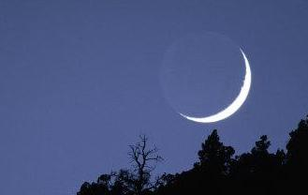
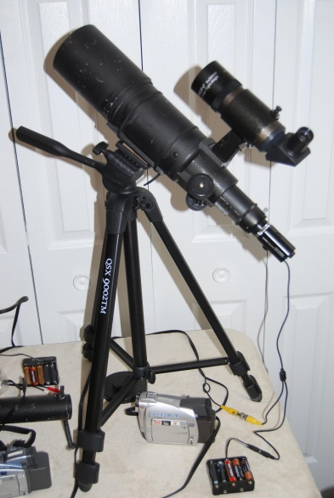
Grazing
Occultation of
3.5-mag. eta
Geminorum in
Arizona,
2011 April 10,
my first success
with remote
mini/midi stations (a humiliating defeat, it was machines, 3; humans, 0)
Moon 36%+
Cusp Angle 15N
Eta Geminorum - Graze

Slide 11
Stations on N. 387th Ave., n. of Tonopah, AZ
N. Remote
Cen. Remote
Attended
S. Remote

Slide 12
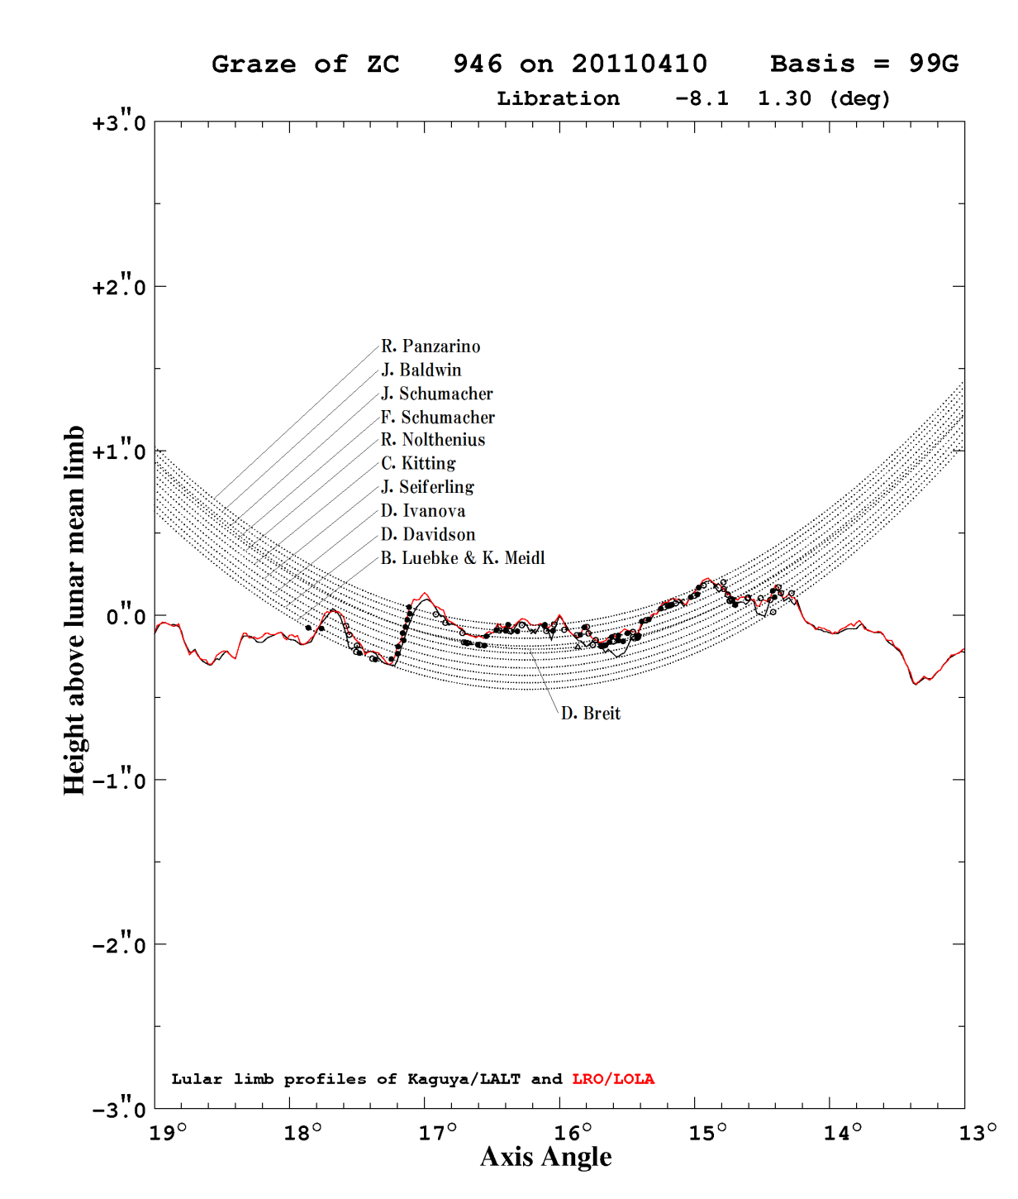
Comparison of Kaguya & LRO profiles
Here is a reduction of observations of the 2011 April 10th eta Geminorum graze by Dr. Mitsuru Sôma at the
Japanese National Observatory. The profiles are close, but LRO’s, with more orbits and points than Kaguya, is more accurate near Axis Angles 14.3 and 15.4.
With multiple stations and LRO data, there are still new things that can be done with grazing occultations!

Slide 13
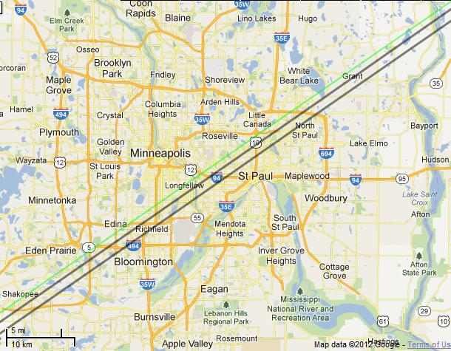
Graze of 4.9-mag. ω² Tauri (ZC 628) over Minneapolis, Minn. on 2012 Aug. 11, Moon 35%-, CA 2N
Google map to plot graze paths & find observing sites
Produced with Occult 4 & at
http://www.timerson.net/iota/
I made plans to observe it from near Grant. With the small cusp angle, I thought that there would be too much glare to record with midi systems, but I took 2 of them, to try, and 2
4-inch SCT’s for attended stations that Joan and I ran. But like in Arizona, the machines triumphed; it was machines, 2, humans, 0. Station 3 recorded 6 D’s and 6 R’s; I’ll play the video.
__
Station 4’s single R indicates a south shift of about 200m; we can still determine corrections to stellar proper motions from graze observations

Slide 14
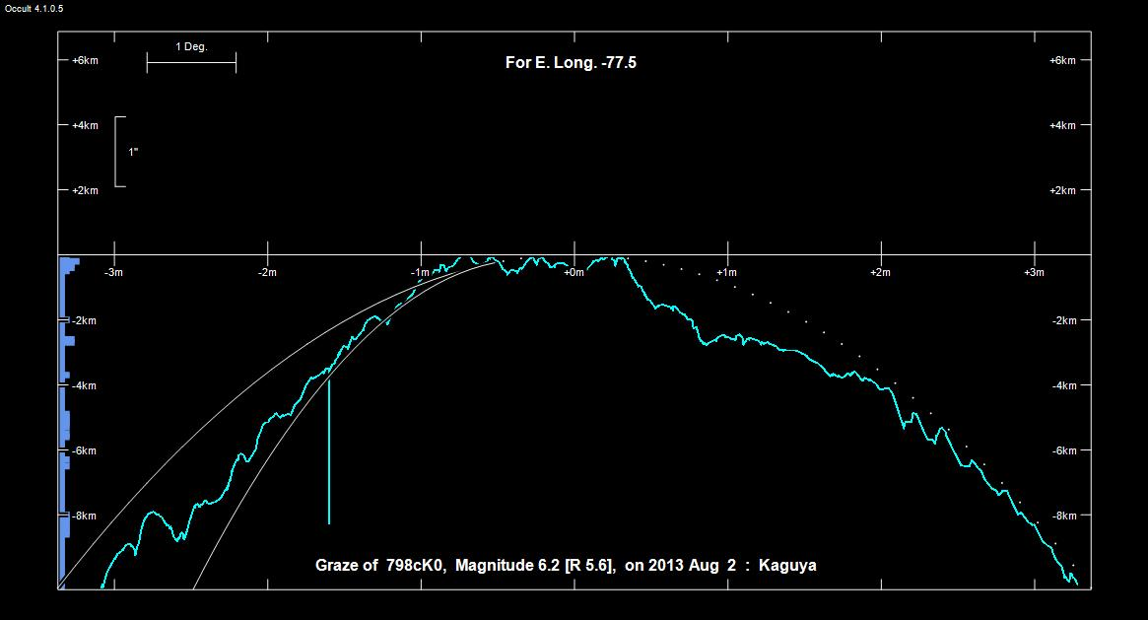
Kaguya profile for graze of 6.2-mag. ZC 798 1° from north cusp of 17% sunlit waning Moon

Slide 15
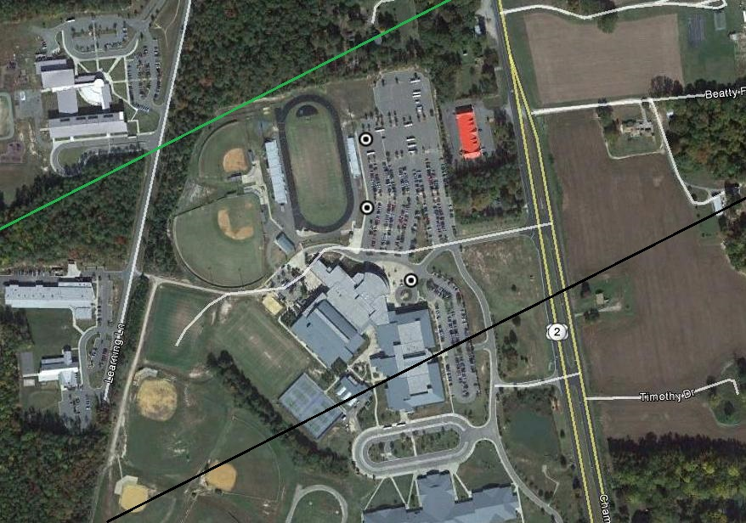
Locations of our 3 stations for the August 2nd graze of ZC 798 in the dark parking
lot of Hanover High School, west of US 301 about 15 miles n.e. of Richmond, VA

Slide 16
Videos and Conclusions
Video of 2007 June 12 mu Arietis graze, 5-in. SCT
Video of 2011 April 10 eta Gem graze, s. sta., 80mm midi
I know of no grazes observed in the USA since the
2013 Aug. graze, except for a couple observed in
n. Calif. (R. Nolthenius, T. Swift, D. Breit)
Grazes are useful for proper motion studies, and for
resolving close doubles better than total occ’ns
(due to grazing geometry, & multiple PA’s)
Grazes provide good practice for mobile observation,
a capability valuable for increasing your number of
positive asteroidal occultations (travel towards
central line for higher event probability, and to
better fill gaps of observers at fixed sites)

